Slide 1

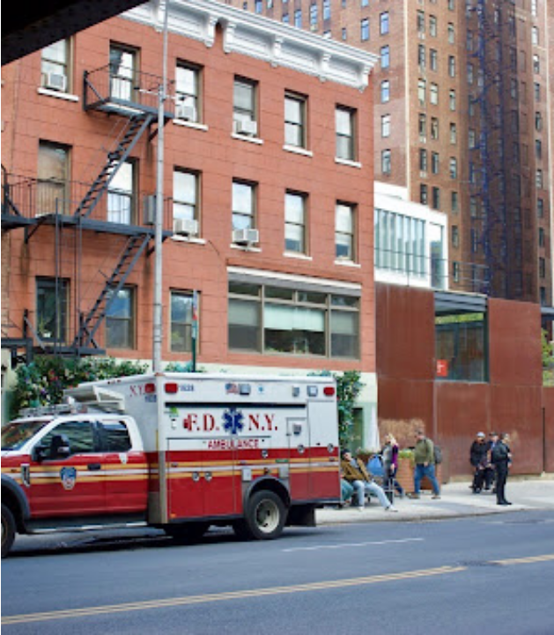
IBM Z Datathon: Theme 3 - Wildcard
PROJECT
DISPATCH
A solution to New York EMS response times.

Slide 2
THE PROBLEM
13 minutes
"PEOPLE ARE DYING BECAUSE THERE ARE NO STAFF,"
Anthony Almojera, a lieutenant paramedic recognising the ever increasing callout time.
AVERAGE DELAY IN AMBULANCE RESPONSE TIMES
MANUAL RESOURCE ALLOCATION
Legacy infrastructure cannot handle the low staffing and high call volume especially in underserved boroughs.
Human error in high-stress routing decisions.
Non-optimised resource allocation adds to an ever increasing response time

Slide 3
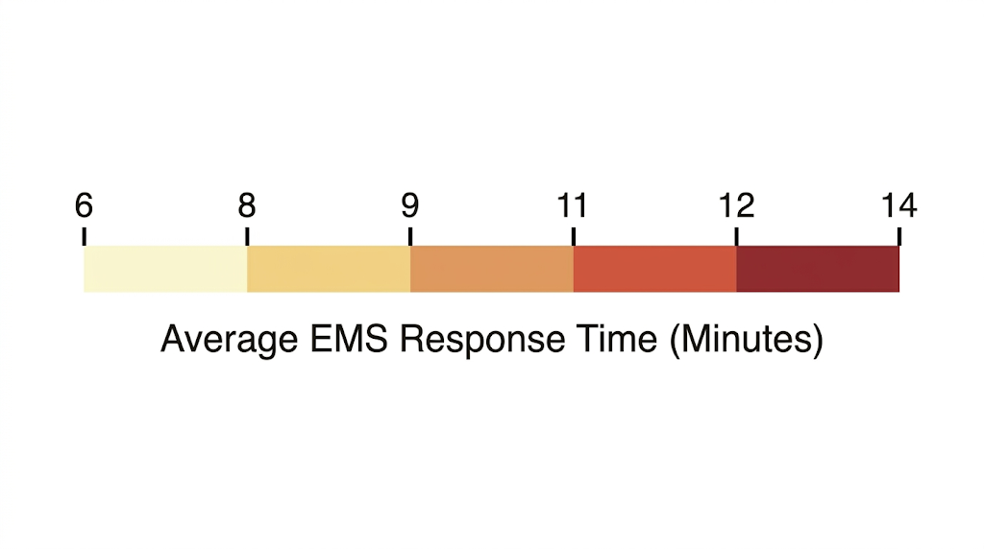
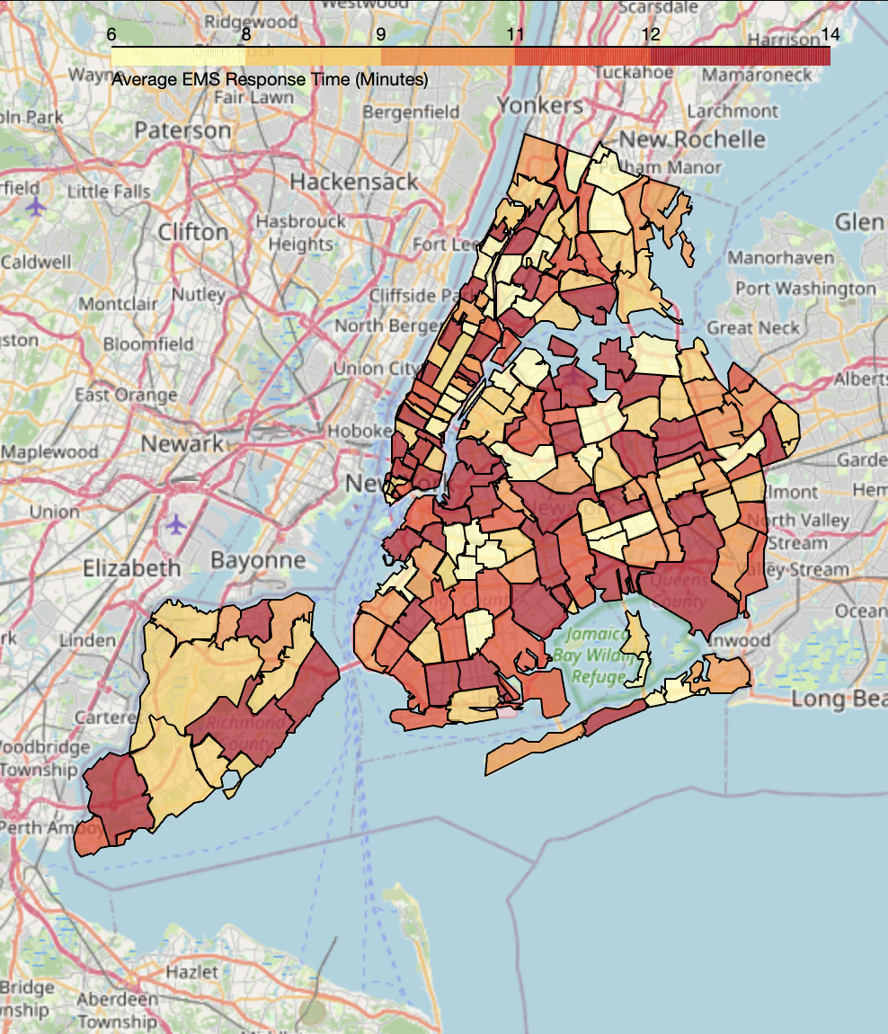
THE TARGET DEMOGRAPHIC
PRIMARY ADOPTION FOCUSED ON DENSE METROPOLITAN REGIONS. MODEL TRAINED ON NEW YORK CITY AS IT HAS THE LARGEST AND MOST INFORMATIVE DATASET AVAILABLE.
490,000
VEHICLES
8.8M
NYC POPULATION
Notes:
Why New York? Key Drivers
Traffic Gridlock: 490,000 cars & 300,000 pedestrians flood Midtown daily, blocking response corridors.
Staffing Shortages: Unprecedented drop in active EMTs creating severe delays.
System Strain: Union leaders warn the EMS infrastructure is at breaking point.

Slide 4



THE SOLUTION
DETERMINING PRIORITY LOCATIONS
PREDICTIVE ROUTING
WEATHER RELATED INCIDENT PREDICTION
AI-driven path optimization.
Analysis of NYC Open Data EMS Incident Dispatch Data
Analyse weather reports to determine preventative action.
STATIC DEPLOYMENT
DYNAMIC DEPLOYMENT
VULNERABILITY

Slide 5






THE TECHNOLOGY
LINUX ONE
1
1
1
1
1

Slide 6
THE DEMO
DISPATCH_SYSTEM_V2

Slide 7
THE COMPETITIVE ADVANTAGE
LEGACY SOLUTIONS
PROJECT DISPATCH
1
1
2
2
3
3

Slide 8



THE VALUE
1
1
1
1
1
1
1
1

Slide 9
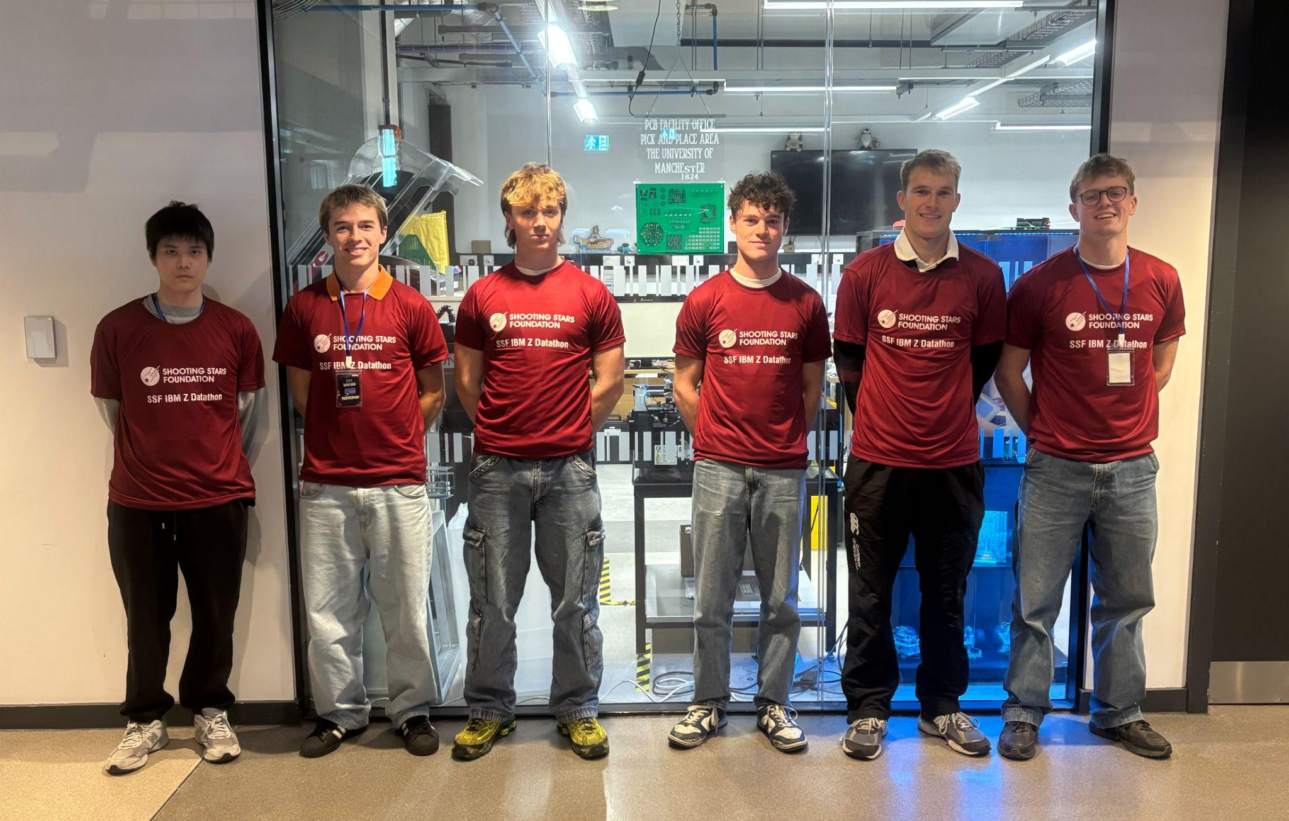
THE TEAM
FREDERIC TATHAM
MAINFRAME ANALYST
NAPAT CHOLLABUD
DATA ENGINEER
JACOB BARTON
DATA ANALYST
DOMINIC EASTON
BUSINESS ANALYST
HARRY ROWLANDS
DATA SCIENTIST
DARRAGH COLEMAN
DATA SCIENTIST

Slide 10
THE FUTURE
BUILDING THE NEXT STANDARD OF URBAN RESPONSE.
Questions & Discussion
jacob.barton@student.manchester.ac.uk
darragh.coleman@student.manchester.ac.uk
harry.rowlands@student.manchester.ac.uk
dominic.easton@student.manchester.ac.uk
napat.chollabud@student.manchester.ac.uk
frederic.tatham@student.manchester.ac.uk

